Slide 1

Team 1 Midsemester Review
HVAC ERecords

Slide 2
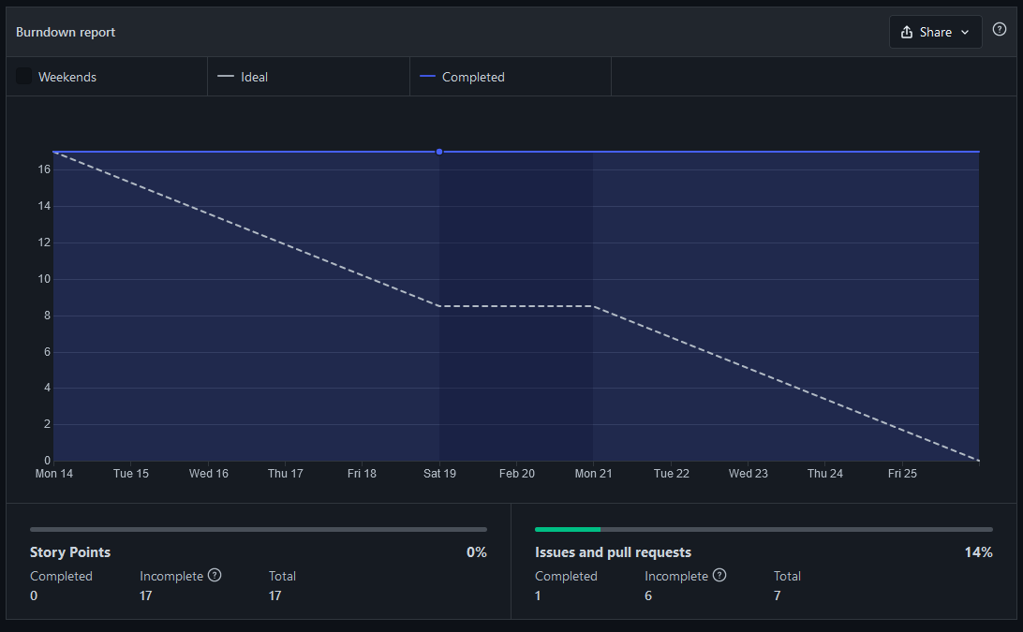
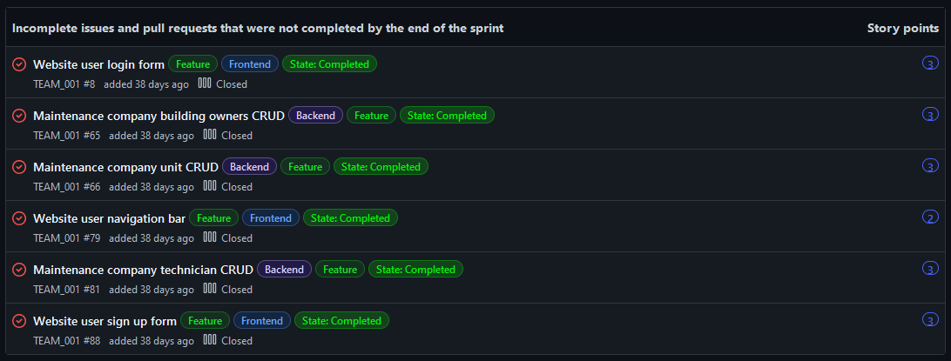
Sprint 1
Progress made
Setup project infrastructure and CI for frontend
Basic CRUD operations and frontend forms
Templates for pull requests/user stories
Split stories into frontend/backend
Problems faced
Sprint ramp up time
Unclear acceptance criteria
Not utilizing ZenHub pipelines and closing completed stories
Solutions found
Improve user stories template for acceptance criteria

Slide 3
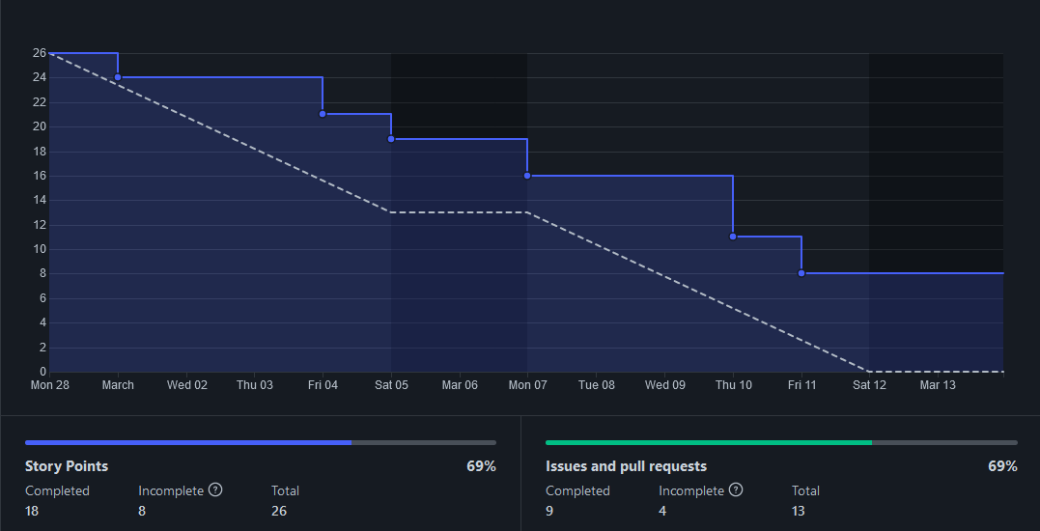
Sprint 2
Progress made
Pair programming sessions
Deployment on Heroku
Less ramp-up time/more progress
Improved acceptance criteria template
Problems faced
Pull requests need to be reviewed more frequent
Some user stories were not descriptive/clear
Solutions found
Check GitHub once per day/request reviewers
Ensure whole team understands user story

Slide 4
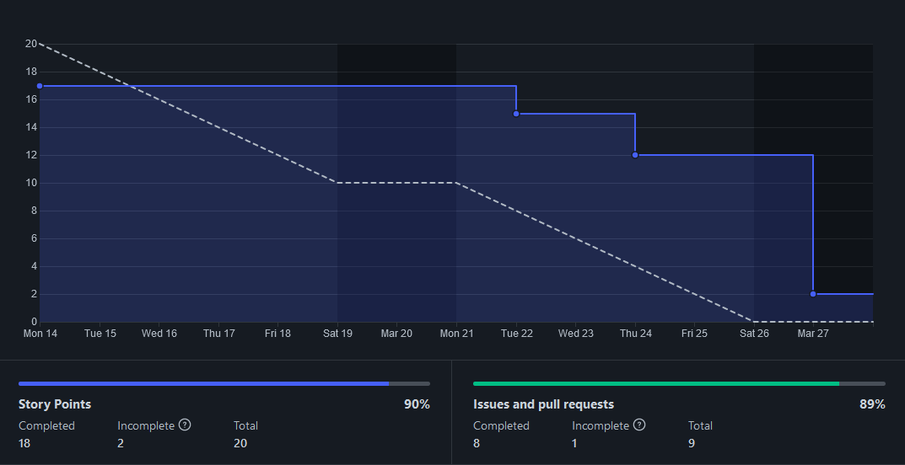
Sprint 3
Progress made
Django CI Testing
Started maintenance records system
Authentication
Problems faced
Wiki/Documentation not staying up to date
Solutions found
Documentation requirement will be enforced requirement on PRs
Previous PRs without documentation will be completed before new issues are started

Slide 5
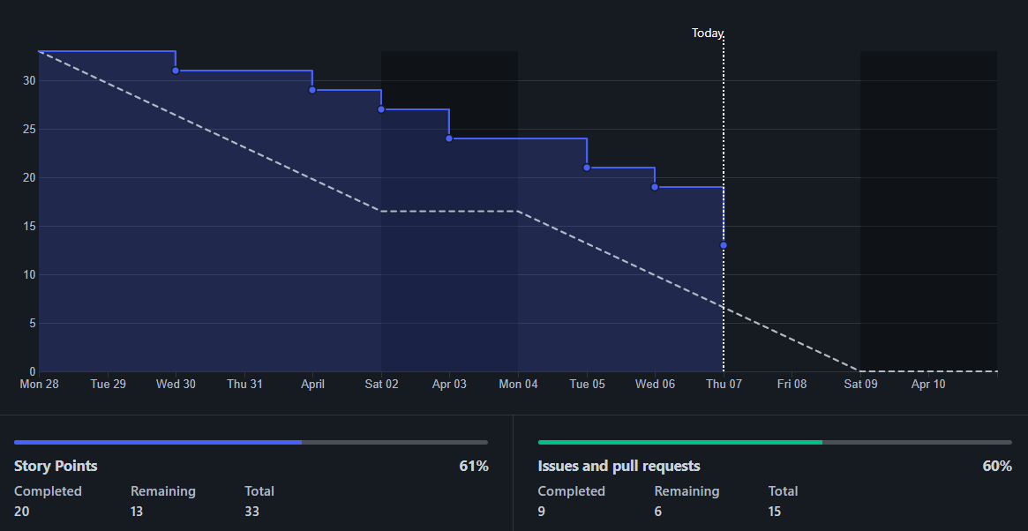
Sprint 4
Progress made
Different account types
(company/technician/manager)
Maintenance companies can
assign/manage maintenance profiles
Problems faced
Pair programming not done soon enough
Solutions found
Require pair programming first week of next sprint

Slide 6







Tech stack
Frontend
Next.js
TailwindCSS
Cypress
Jest
Backend
Django
REST API Framework
Django built in unit test
PostgreSQL
Heroku

Slide 7
Testing
Jest (Frontend React Component Unit Testing)
96% C0 Coverage
Cypress (Integration Testing)
96% C0 Coverage
Django's unit test (Backend Unit Testing)
98% C0 Coverage
Acceptance testing
Product Owner defined the acceptance criteria for the user stories
Customer and developer acceptance criteria in each user story

Slide 8
Our value to the company
In depth documentation
Require documentation of new feature in pull request
Testing process
Require tests for new feature in pull request
Code coverage presents in CI for frontend/backend
Meetings
Pull requests
Templates
Separate branch for development/main

Slide 9
Demo
https://hvac-erecords.herokuapp.com/

